Slide 1
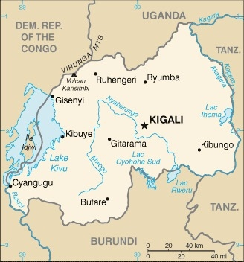
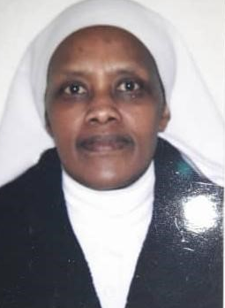
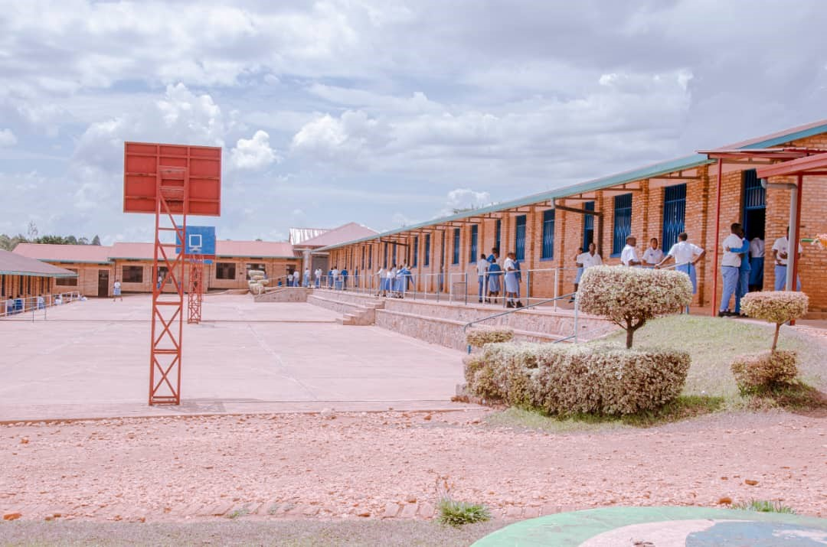
Rwanda: College Immaculée Conception, Benebikira Sisters Congregation
LOAN DETAILS
LOAN AMOUNT $ 150,000
INITIAL INVESTMENT 11/2022
Benebikira Sisters
College Immaculée Conception:
IMPACT
SHARED PROSPERITY
Location: Butare, Rwanda
Creation of new jobs: Full-time employment to increase from 78 to 87 and part-time employment to increase from 30 to 34 casual laborers post-investment.
Size: 450 Students
INVESTMENT OVERVIEW
ENTERPRISES
Secondary school for boys and girls
USE OF LOAN
Construction of science laboratories
Refurbishment of administrative building
Purchase of ICT equipment
INVESTMENT HIGHLIGHTS
The school provides quality education for children in a rural area, reducing what would otherwise be a long walking long distance to the nearest school
The school provides full scholarships for at least 10 students per year and offers subsidized tuition for at least 20 students per year, improving education access for the most vulnerable children living in a remote area
RESILIENCE / LAUDATO SI’
The students and staff do community work for the most vulnerable once per month
The school is currently planting 150 trees annually and plans to increase to 200 trees annually post investment
FOOD SECURITY
The school provides daily meals to the students
Project Leader Sr. Catherine Kazibera
The Project Leader talking to a student in the school
STRENGTHENED SOCIAL ENTITIES
Supports 4 Nursery Schools, 3 private secondary schools, one training and vocational center and 10 Subsidized secondary schools
MISSIO INVEST ADVISORY &
SUPPORT
Missio Invest’s Country Investment Manager will work with the borrower to improve their financial record keeping and impact reporting
Basketball courts on the school grounds
Page 8

